Slide 1
Chapter 2：The Future of Road Safety
Background: Traffic Safety, A Growing Concern
Systems Approach to Safety
Identify Problems
  Formulate Strategies
  Set Targets
  Monitor Performance

Slide 2
Chapter 2：The Future of Road Safety
A 、Experience
    美国：
    中国：
B 、 Hot Subjects of Safety Research

Slide 3
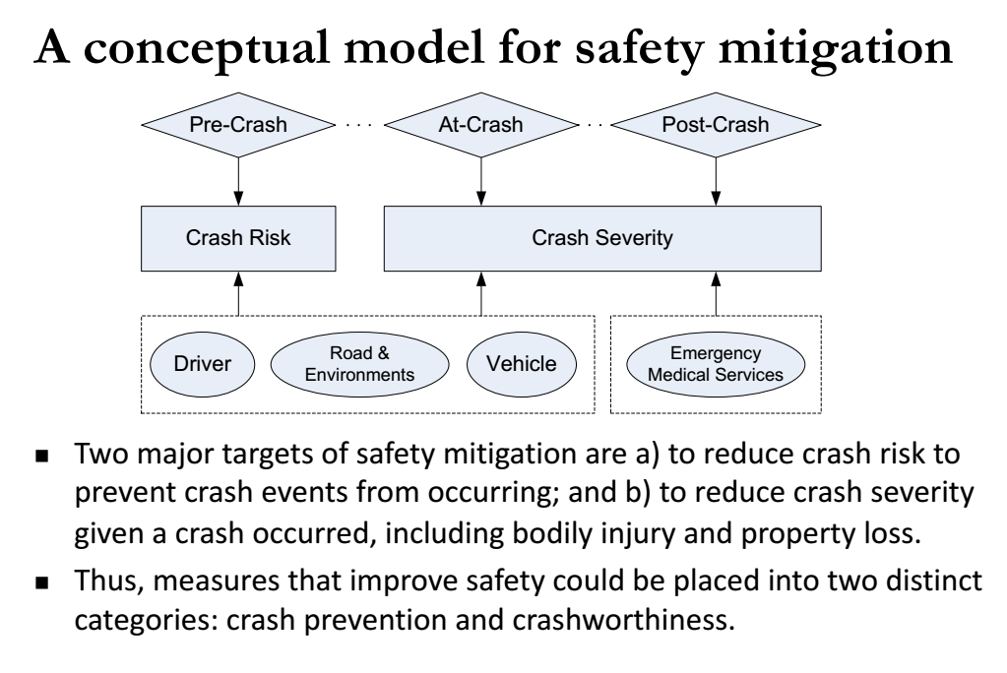

Slide 4
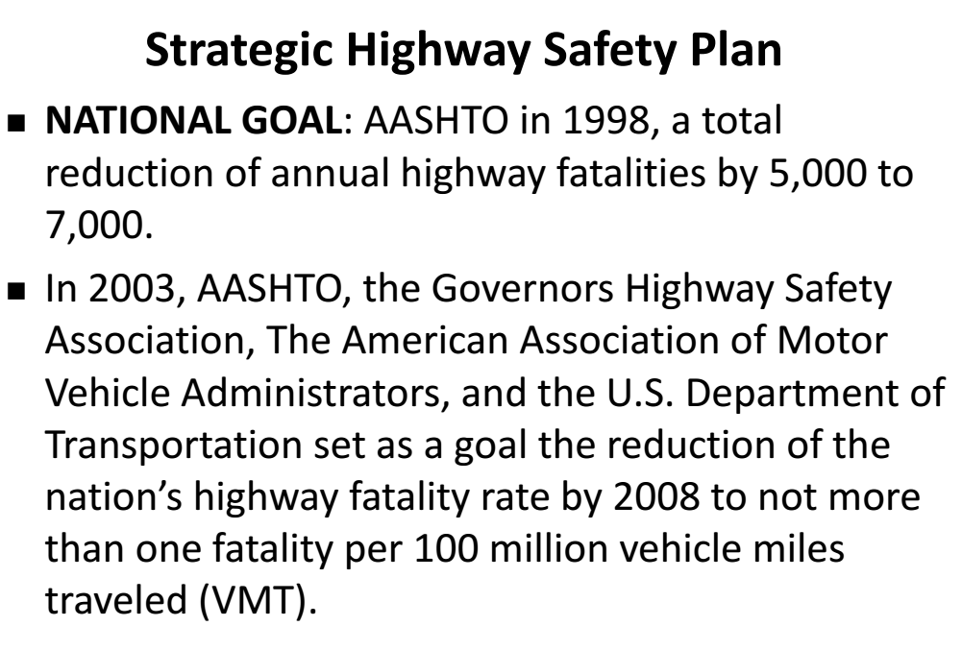

Slide 5
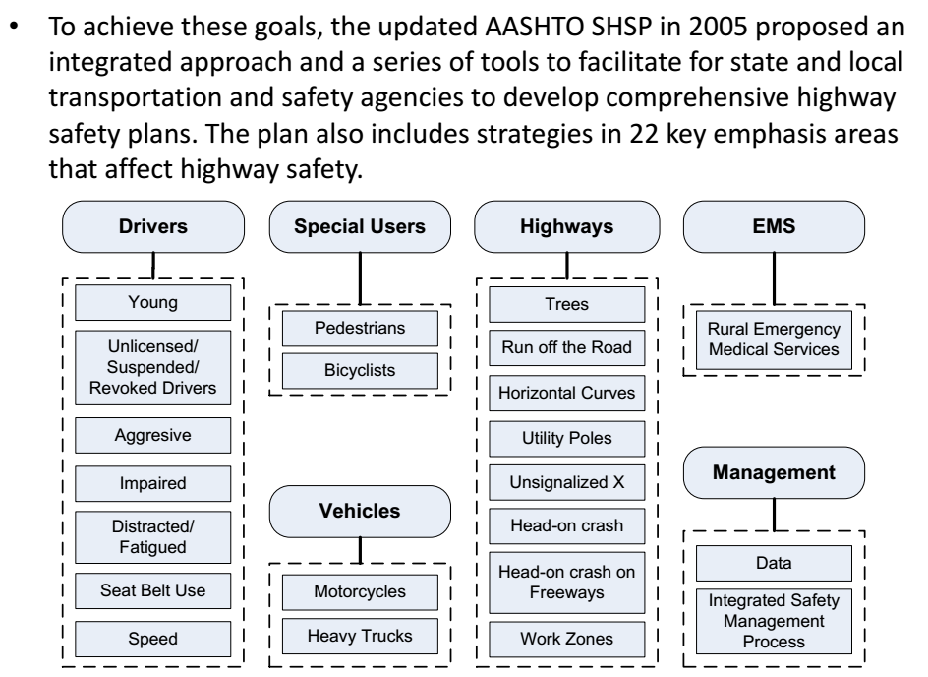

Slide 6
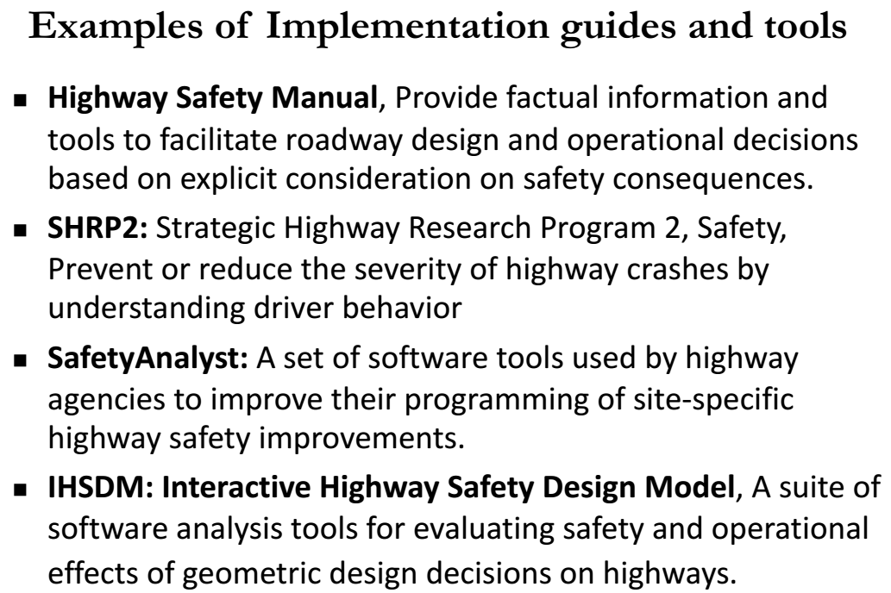

Slide 7
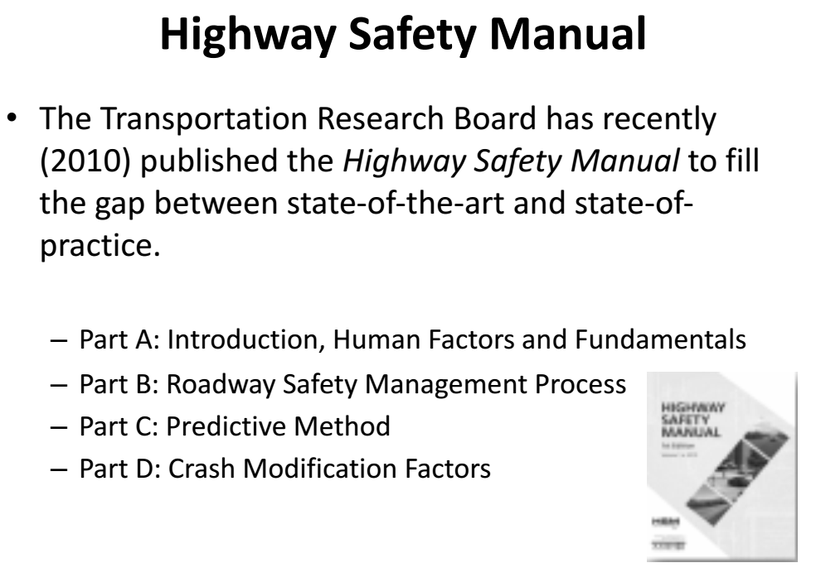

Slide 8
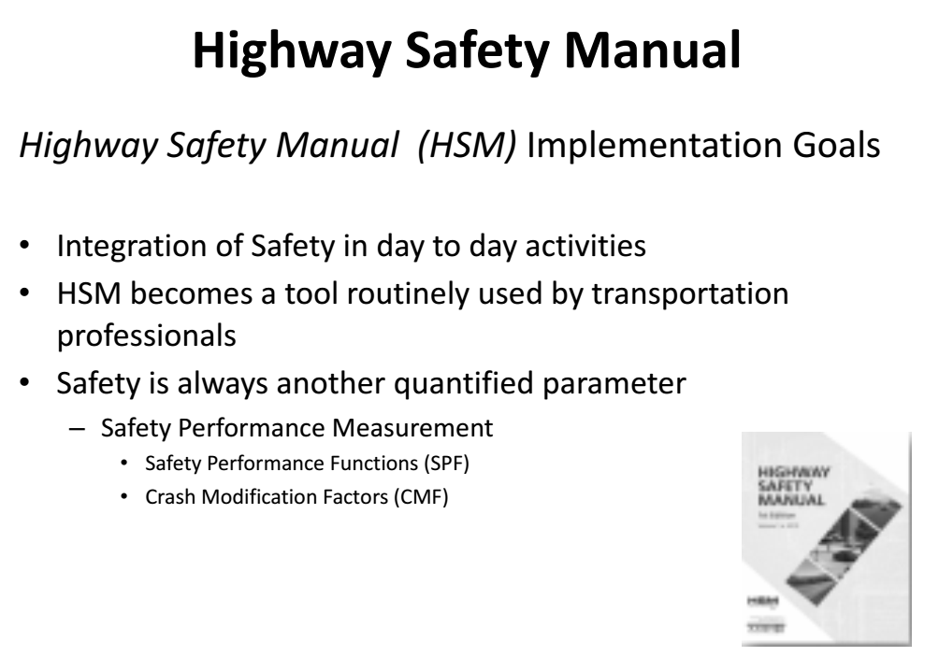

Slide 9
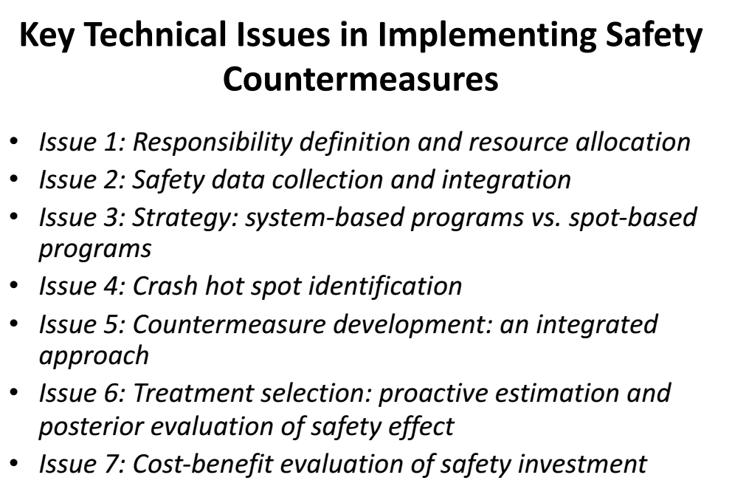

Slide 10
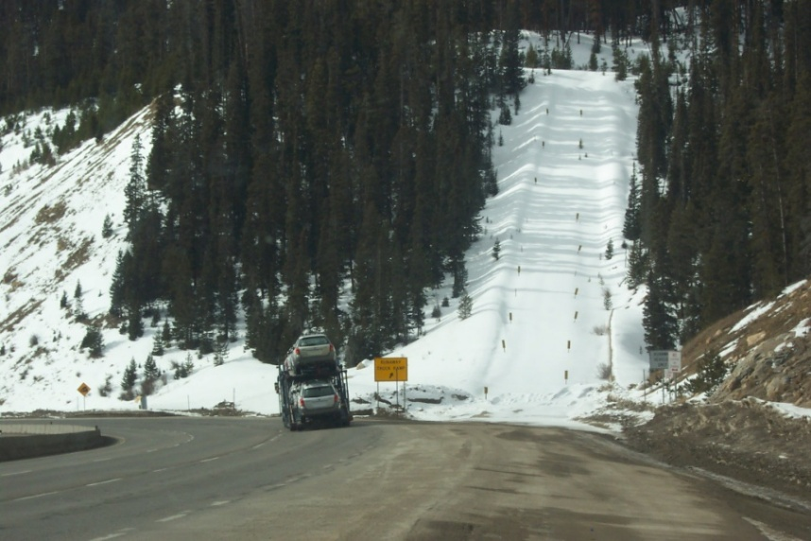
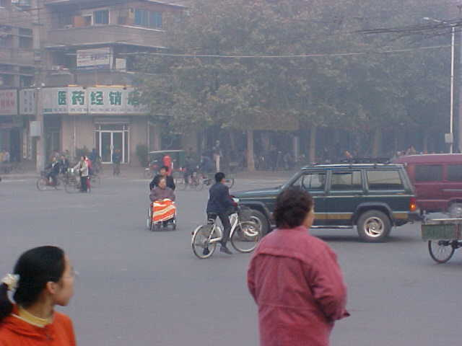
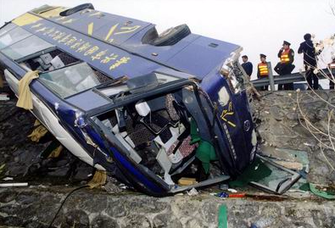
  中国：
根据我国公路事故统计数据的部分结果，交通事故的多发区为：
- 雾区气候条件
- 连续长大下坡路段
- 隧道进出口的过渡段
- 平交路口：交通事故的集中发生地
- 路側：车辆冲出道路是路段恶性交通事故的主要直接原因

Slide 11
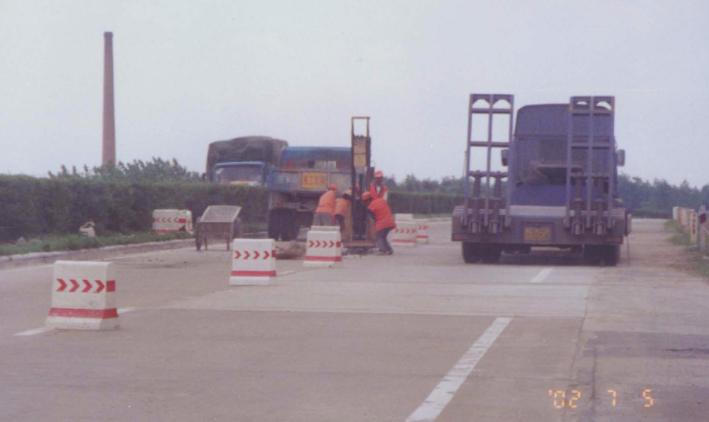

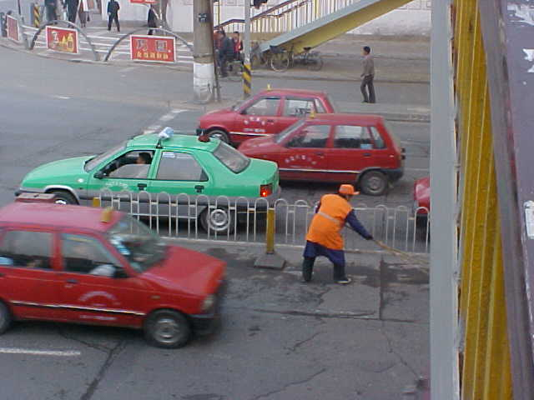
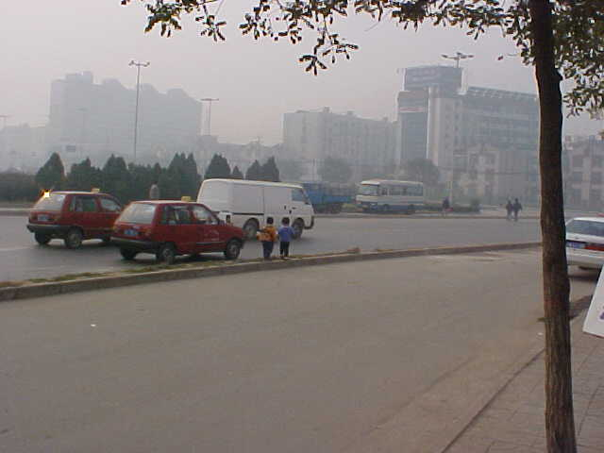
我国道路交通安全所面临的挑战
道路交通安全基础薄弱
  使用者素质
  道路设计/交通管理合理性
  执法力度和素质

Slide 12
交通事故责任归属的法律界定及误区
交通需求与交通安全需求的平衡（侧重点的转移）

Slide 13
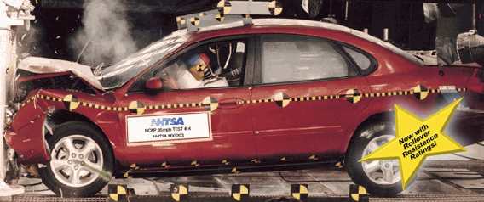
道路交通安全战略与战术
战略的需求与战术的需求同样重要
制定国家/省一级的道路交通安全战略的重要性
在规范、标准、设计中考虑交通安全的影响
大力投资交通安全研究项目
强化交通教育和执法力度

Slide 14

在今后的若干年将承受越来越大的交通安全的压力
解决问题的办法：制定各级交通安全战略规划，更多地从规范、标准、设计中着手
强化“教育/宣传”的作用

Slide 15
  中国：
    自2000年以来开展了大量交通安全研究与工程实践
    国家层面的安保工程及实施（始于2003年）
    国家科技攻关、交通运输部西部科技项目（始于2005年）
    国家科技支撑计划（始于2008年）
    国家层面的交通安全生命防护工程（始于2014年）
    国家科技重点专项
    ……
    存在的问题：事故数据的利用；
    规划、标准严重滞后！

Slide 16
热点在哪里？
如何追逐热点？

Slide 17
Traditional Safety Approach
Mostly Re-active
  Depend on black “hot” spot identification and identifying the factors that contribute to crash occurrence and severity
  Problems already occurring and damage already done
  Important but not enough
  Challenges are increasing and resources are limited
Strategic National Highway Safety Plan
Road Safety Audits
Incorporating Safety in Design

Slide 18
Advances in Traffic Safety
Pro-Active Approaches
Transportation Safety Planning (TSP)
Real-Time Crash Prediction
Microscopic Traffic Simulation in Safety Research
Intelligent Transportation Systems’ Applications
Using Driving Simulators to Evaluate Safety
Strategic National Highway Safety Plan
Road Safety Audits
Incorporating Safety in Design

Slide 19
A 、Experience
    美国：
    中国：
B 、Hot Subjects of Safety Research

Slide 20
Transportation Safety Planning
    Traditional safety analysis is mostly reactionary to the existed or planned transport system.
    Safety historically has not been an explicit part of transportation planning. However, road safety is affected by how the transportation system is designed, constructed, operated, and maintained.

Slide 21
  Given that transportation planning leads to changes in transportation system, safety should be integrated in the planning process.
  A clear need has developed for safety to be proactively considered as part of the planning process, which leads to the concept of Transportation Safety Planning (TSP)– one of the next generations of road safety strategies.

Slide 22
Driver Behavior and Psychology
强调“人”的因素及道路的“宽容性”设计；
主动预防性（行为干预）交通安全改善；
预测模型的精度、适用性或可靠性；
典型驾驶行为对交通安全的影响。
——交通安全改善更有针对性。

Slide 23
Safety Evaluation and Data Analysis
To establish the relationship of crash frequency and severity to various contributing factors.
Traditional methods: Multiple Linear Model, Poisson Model, Negative Binomial Model, Discrete Choice models.
Emerging methods: Data mining, Bayesian statistics, multilevel models.
  Model is important, but not the most important!

Slide 24
Analysis Coordination and Communication among Driver, Vehicle and Road Environments
Most situations in driving involve more than one road user and interaction among those road users and road environments.
The coordination and communication among driver, vehicle and road environments are a hot topic in improving traffic safety. ITS technology is a major measure.
For example, Intelligent traffic control and management, real- time detection and warning for adverse weather or special events, automatic incident detection system, computer-aided driving etc.

Slide 25
交通安全改善
—我们能做什么？
—我们应该做什么？

